Slide 1
From white powders to prescription medicines
How drugs are developed
Dr Graham Hughes

Slide 2
NB
In this presentation I am concentrating on drugs developed for non- cancer indications and for small(ish) chemical entities
Cancer drugs are normally not tested on healthy volunteers and have rather different methods of development
Biological entities e.g. antibodies or proteins, are developed rather differently
I am not going to talk about vaccines - either

Slide 3
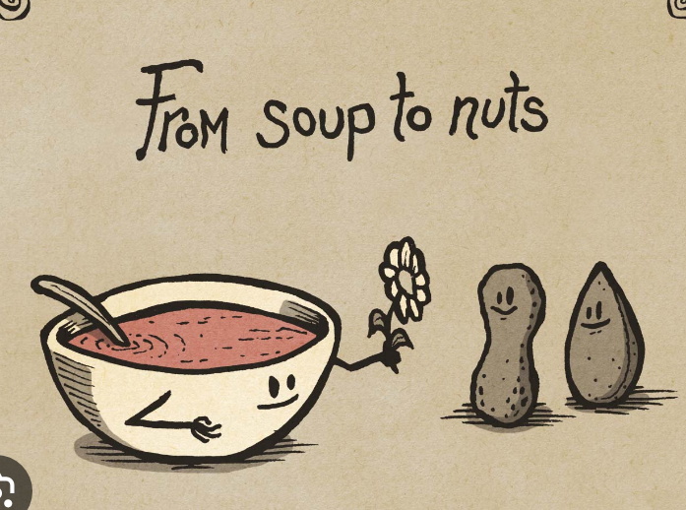

Slide 4
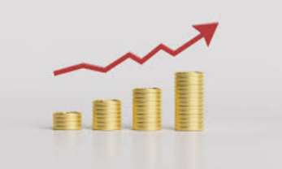
What am I going to talk about?
Discovery
Screening
Toxicology and animal testing
Patents
Phase 1 studies
Phase 2 studies
Double blind
Placebo effects
Phase 3
Ethics
Regulation
And of course, money

Slide 5
What do you need to develop a drug?
Chemists who synthesise or discover new chemical entities
Biologists who find targets that mimic the disease and who test them in animal models and animals themselves
Healthy volunteers
Patients suffering from the particular disease
Doctors and nurses who treat them
Pathologists who can analyse blood samples
Clinical scientists who plan and run research programmes and mathematicians to help analyse them
Chemical engineers who make commercial quantities of the drug
Time
Patents
Lawyers
Economists And
MONEY - lots and lots of it

Slide 6
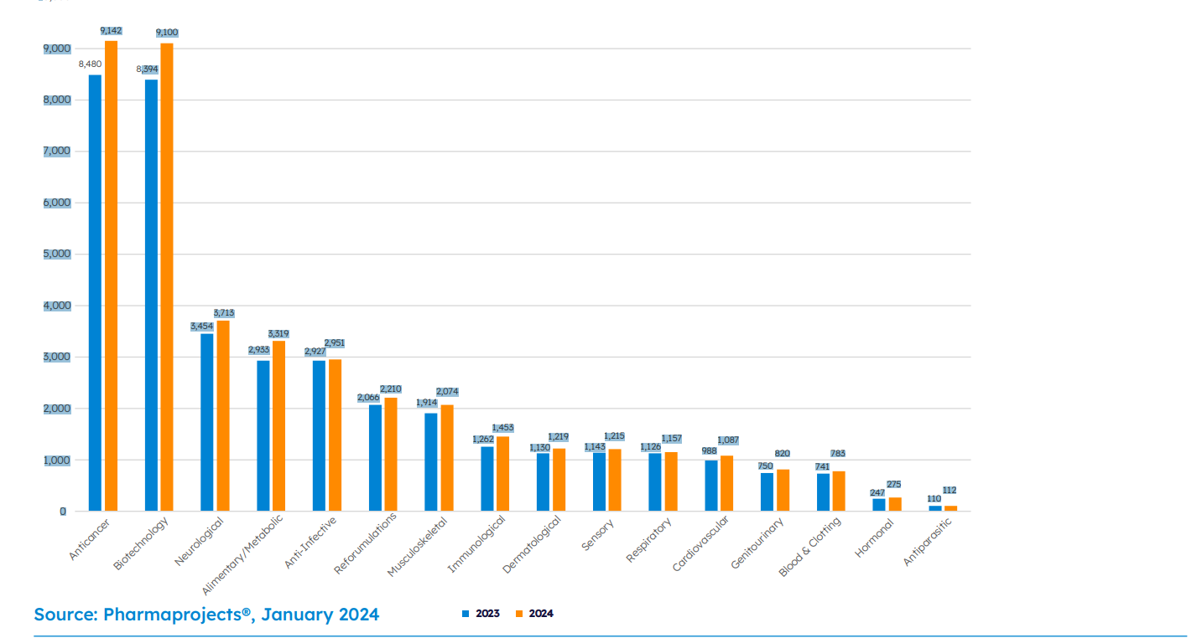
For what diseases are drugs being developed?

Slide 7
Rare diseases
Never a primary target for Pharmaceutical Companies
Not economically worth while without governmental assistance
Orphan Drugs
  In the European Union, orphan drugs are intended to treat conditions that affect fewer than 5 in 10,000 people.
  In the United States, orphan drugs are intended to treat conditions that affect fewer than 200,000 people.

Slide 8
Let’s start with the money
In 2001, researchers from the Tufts Center for Drug Research estimated that the average cost of developing a drug was $802 million (if you took failures into account)
By 2014 this had risen to $2.0 billion
By 2024 this figure had stabilised to around $2.3 billion
But even without failures the costs run from $172 million to over $4 billion for some drugs
As a consequence, nearly all drugs are developed by big companies
And why does it cost so much??
  -I’ll come to that later

Slide 9
Where do the “white” powders come from?
As of February 2021, there were about 177 million chemical compounds registered in public databases.
Scientists estimate that only 1% of all possible chemical compounds have been synthesised or discovered.
And they are made/discovered by research chemists - mainly in industry but also in academia
  By taking a known compound and changing it a bit – by adding, deleting or swapping some atoms.
    Tiny changes can make a huge difference
  Or by taking a known chemical reaction and using new starting materials.
  Or by analysing plants, fungi or bacteria and even soils.
This can lead to huge so-called libraries of compounds to be tested against targets
There may be millions of compounds in a library

Slide 10
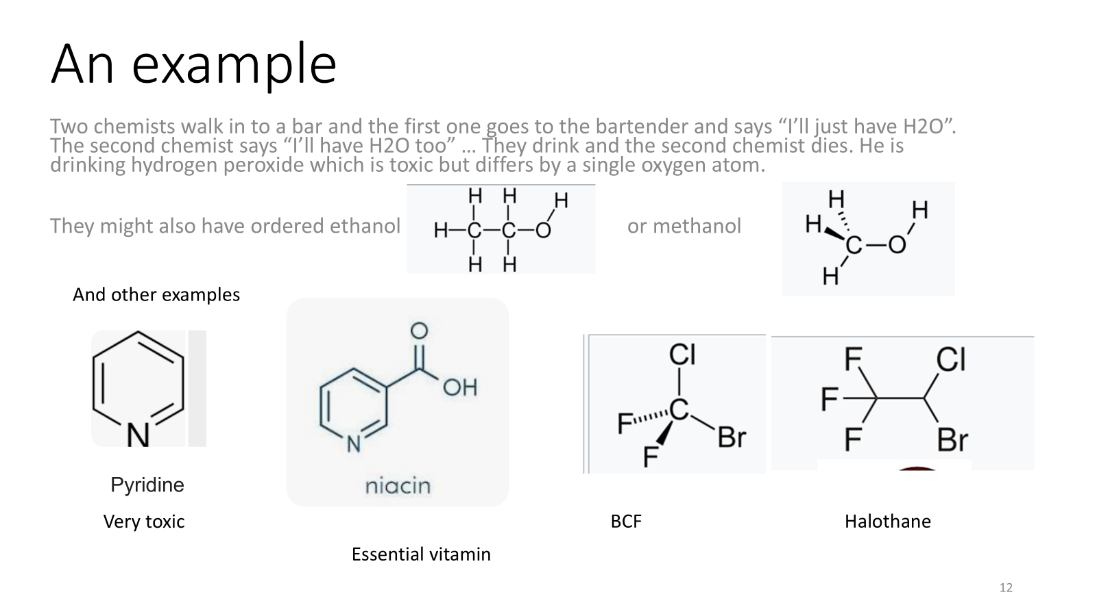

Slide 11
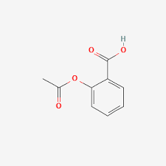
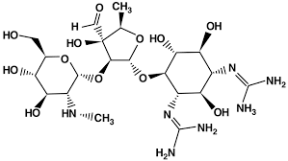
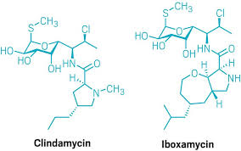
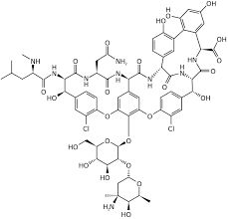
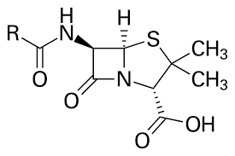
Aspirin
Streptomycin
Penicillin
Glucoside antibiotic

Slide 12
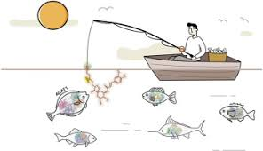
What happens to a new compound?
It is tested in the laboratory to see if it interacts with a target
And then the strength of the interaction is measured.

Slide 13
What are targets?
A disease target is a biological molecule, pathway, or response that is associated with a disease. It is a potential target for a drug that can be used to treat the disease.
  A protein
  An enzyme (e.g. acetylcholinesterase ACE)
  A particular molecule (serotonin)
  A pathway – (such as a hole in a cell wall)
  A cell (e.g a cancer cell)
  A parasite itself (malaria)
  DNA or RNA
The targets are put into arrays (e.g. 20x20 or bigger) and subjected to portions of the families

Slide 14
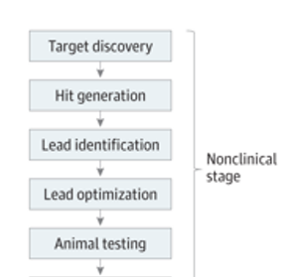
Preclinical testing
New chemical entity
Strong interaction
Modified NCE
Modified NCE
The Phase 1 clinic

Slide 15
Animal testing: why and how?
Toxicity
Irritancy
Pharmacokinetics
  What the animal does to the chemical(and how fast)
Pharmacodynamics
  What the chemical does to the animal
By giving small and increasing doses to a range of animals starting with rodents by injection, inhalation or ingestion
Often carried out by Contract Research Organisations
Without animal testing no drug can be legally developed
Will continue after the first administration to man with long term testing
If the results are promising then proceed to Phase 1
But chemists have to get to work

Slide 16
What chemists have to do now
Make larger quantities for the next set of tests
Work out how to produce commercial quantities and (gu)estimate how much it might cost
Develop new formulations
  Tablets or capsules (ideal)
  Injections
  Slow release formulations
  Dermal or ocular formulation
  Help lawyers protect intellectual property

Slide 17

Patents
  What is a patent?
A patent is a legal right granted to an inventor or applicant by a government authority, giving them the exclusive right to make, use, sell, or distribute their invention for a specified period, typically 20 years from the filing date.
Novelty: The invention must be new and not previously known to the public before the patent application date.
Inventiveness: It should not be an obvious modification of existing inventions.
Industrial Applicability: The invention must be capable of being made or used in some kind of industry
Patenting world-wide is an expensive business

Slide 18

Patents
Patents are territorial; protection is limited to the country(ies) where the patent is granted. (not necessarily the country where the invention takes place)
The pharma industry patents new drugs widely – US, EU/UK,. Japan being the main countries
Patents can cover a whole family of drugs
When a patent expires competitors can exploit the original invention
So, time can be of the essence
Pharmaceutical patents play a vital role in fostering innovation within the healthcare sector by protecting intellectual property and incentivizing R&D investments.
If it takes 10 years to develop from discovery to approval , companies may have only 10 yr-ears of exclusivity

Slide 19
Phase 1 Trials*
Testing the candidate drug on healthy volunteers
A series of Phase 1 trials generally lasts several months to over a year
The are mostly performed in specialised clinics run by independent contract research organisations (CROs)
They are performed under strict government authorisation/regulation
  Safety is a prime consideration
  Ethical considerations must be taken into account
Volunteers are protected
  Not paid too much (minimum wage)
  No used too often (once or twice a year )
  Not used more than once with the same drug candidate
They can take place in any country but mainly in Western Europe, North America and India
Cost several thousand pounds for each volunteer (up to 100)
* Also known as first administration to man

Slide 20
Phase 1
Administer about 1% of the minimum dose that shows a toxic effect in animal testing (usually intravenously)
In a clinic that is like a hospital intensive care unit
Start with just one volunteer
Take frequent blood samples and analyse for the drug and its metabolites
Measure all vital signs - often
    Look for unexpected effects
Remarkably good safety record

Slide 21
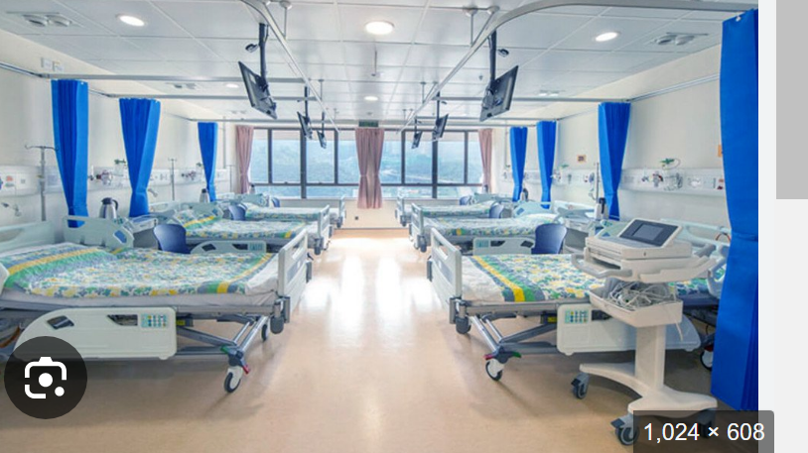
Typical Phase 1 Unit

Slide 22
Phase 1 continued
If the one volunteer test looks safe(without serious undesirable side effects) then:
  Dose up to 12 volunteers
Volunteers are usually healthy young men (18 to 40)
Analyse the results to see what the body does to the drug
  Is it metabolised?
  To what ?
  How quickly ?
  What is the half life
Look for the pharmacodynamic effects – what the drug does to the body
Gradually increase the dose to what might be the therapeutic dose in patients
Obtain a picture of how the drug is absorbed, distributed, metabolised and excreted (ADME)

Slide 23
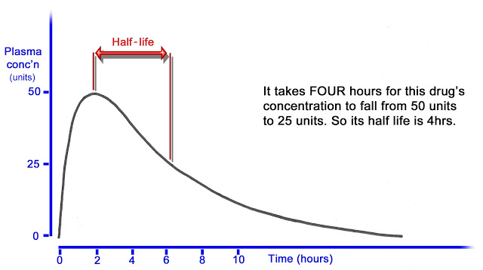
Half life

Slide 24
Special Phase 1 Trials
Studies in special populations
  Female
  Elderly
  Rarely children(special conditions apply)
    They are NOT small adults
Drug/drug interactions
Smokers
Alcohol interaction
Radiochemicals

Slide 25
WHAT IT'S LIKE TO PARTICIPATE?*
As a healthy volunteer, before the trial begins, you’ll go through a screening process. During the trial, we’ll carefully monitor you for side effects. Our trials are also reviewed and approved by the appropriate regulatory authorities and ethics committees
Throughout the trial, you’ll have a team of medical professionals dedicated to your care, including nurses and doctors.
All medical exams, tests, and/or procedures you receive during the study are provided at no cost to you as a healthy volunteer.
Healthy volunteers for Phase I clinical trials don’t experience any therapeutic benefits because they don’t have the condition the medicine is targeted at, so they’re usually compensated for their commitment.
*According to Parexel

Slide 26
A typical short study (quoted verbatim)
Healthy participants needed for the study of a potential new treatment for treatment-resistant depression. The study drug is a man-made form of a natural psychedelic drug. You must be aged 18 to 64, have a BMI between 18.5 and 35, and not have used any nicotine products in the last 6 months. Women able to have a baby must be on contraception. It involves 1 night’s residence, 2 telephone calls, 1 video-call, and 1 follow-up. Next admissions expected in Spring 2025.

Slide 27
Phase 1 results
Bad
Good
No absorption
Too rapid metabolism (short half life)
Unacceptable/toxic metabolites
Unacceptable pharmacodynamic effects e.g.
  Pain
  Drowsiness or light-headedness
  Diarrhoea
  Increased blood pressure
  Change in appetite
  Nausea
  Etc
Acceptable (anticipated) metabolites
Acceptable pharmaco-kinetics
  Goldilocks
Acceptable ADME
Acceptable dose level
Abandon (70% + of the time) Proceed to Phase 2

Slide 28
Phase 2
Phase II studies determine the effectiveness of an experimental drug on a particular disease or condition in approximately 100 to 300 volunteers.
This phase may last from several months to two or more years.
A Phase II trial starts to answer the question, "Does Drug X improve/cure Disease Y?"
A secondary objective for a Phase II trial is to ascertain therapeutic dose level and dosing frequency.
This answers the questions, "What quantity of Drug X works better on Disease Y, (e.g. 1 mg, 20 mg or 300 mg)?" and "Does Drug X work better on Disease Y taken once or twice or more often, a day?“
A third objective is to begin to examine potential side effects in patients
Cost effectiveness begins to be considered

Slide 29
Phase 2
Nearly always takes place in a hospital setting.
Several centres are generally used
Overseen by a Consultant level doctor (principal investigator)
Designed by the drug company
Patients are generally not paid (in Europe) but are paid expenses
Studies are double blind
Extensively monitored by clinical research assistants (CRA) using case record forms (CRF)
Must be approved by a health regulatory agency eg MHRA
Must be approved by an independent Ethics committee
Can be managed by CROs

Slide 30
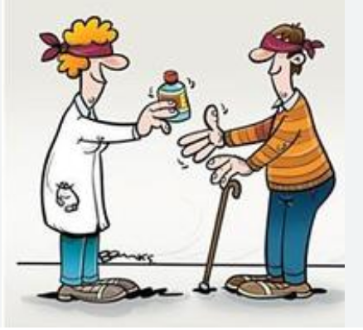
Double blind studies
A double-blind study is a clinical trial where neither the participants nor the researchers know which treatment a participant is receiving.
This is done to reduce bias and make the study results more reliable
Usually the patients are divided into groups where one (or more) group gets the drug and another equally sized group is given a placebo (or the standard treatment for that disease)
  A computer randomly assigns each participant a code number
  The code number is attached to the treatment the participant receives
  The list of participants and their code numbers is kept secret until the end of the trial
Bias can occur when participants or researchers know which treatment a participant is receiving
Double blind studies can reduce or eliminate “placebo effect”

Slide 31
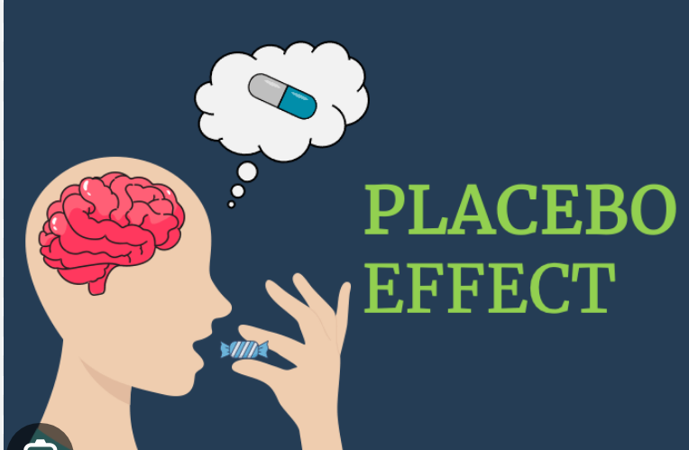
What is the placebo effect
The person's expectation of feeling better can trigger the placebo effect.
A placebo effect may be as high as 50% of patients
Hence the need for big trials
The placebo effect is when a person's health improves after taking a fake treatment, or placebo. This happens because the person believes the treatment will help, not because of the treatment itself.
Examples A sugar pill, A salt water injection

Slide 32
Phase 2 trials
Extensive tests on the patient
  More pharmacokinetics
  Many tests of blood chemistry
  Many objective tests (biomarkers)– not just “do you feel better?”
Typically involving a few hundred patients, these studies aren't large enough to show definitively whether the drug will be beneficial. Or commercially viable
Approximately 33% of drugs move to the next phase
Phase 3

Slide 33
Why do Phase 2 trials fail?
Disease heterogeneity
        Unknown or known interpatient differences in disease not properly controlled and absence of a predictive biomarker
        Poor understanding of the target biology and target/pathway-associated biomarkers
Dose
    Range too low or too high
Treatment duration
  Treatment duration too short for efficacy

Slide 34
Why do Phase 2 trails fail?
Concomitant medications
              Medications that suppress or mask or interfere with response to active treatment
Geographic
  differences in treatment methods and standards
Clinical end points
  Not consistent or reproducible
Unacceptable adverse events
Poor patient recruitment
Bad designs- not statistically significant (5% chance)

Slide 35
Phase 3 Trial
A study that tests how well a new treatment works compared with a standard treatment and how safe it is.
For example, Phase III clinical trials may compare which group of patients has better outcome, survival rates or fewer side effects.
Phase III studies are conducted at multiple centres with several hundred to several thousand patients for whom the drug is intended
Massive testing of a drug provides continued generation of data on a drug's safety and efficacy. As in Phase II, most Phase III studies are randomized and blinded.

Slide 36
Phase 3 Trials
Conducted in both hospitals (for serious diseases) and general practice
Designed by Pharmaceutical companies
Manged by the company or often by a CRO
Often international
As in Phase 2 many parameters are measured
  Blood pressure / heart rate etc etc
Often carried out with patients with multiple diseases
Even big trials cannot reliably detect rare side effects

Slide 37
Phase 3 Trials --- examples
Hypertension 300 patients in general practice using GPs with further degrees
Obesity : 2539 patients in 4 groups (3 treatment, one placebo) (Europe wide)
Osteoporosis: 21000 patients in 3 groups in Europe and USA
  I was told this cost over $1million a week!
  This went on for 2 years
  And monitored lightly for a further 5
Bacterial meningitis 30 patients – Africa

Slide 38
More about Phase 3 studies
Phase 3 trials can take many years to complete.
Researchers might study the experimental treatment in different doses or with other treatments.
Often, Phase 3 studies check how well the experimental treatment works over a longer period of time.
They might include types of patient different from earlier phase clinical trials

Slide 39
Even more about Phase 3 trials
They might study how well the experimental treatment works in younger or older people.
Or even children
Depending on the intended patient population, these trials will include men and women, as well as people of different ages and racial and ethnic groups, if possible.
Participants in these trials should represent the patients who are intended to use and benefit from the treatment if it is approved.
May include a guarantee to continue the treatment after the formal termination of the trial – if no serious adverse events are recorded

Slide 40
More about Phase 3 studies
Phase 3 studies must always be pre-approved by a Medicines Regulatory agency
  MHRA (UK), EMA (EU) FDA (USA) etc
Details of the study must be registered in a Clinical Trial Register
The sponsor(Pharmaceutical Company) must agree to publish the results
As with Phase 1 and 2 the study must be approved by an Ethics Committee
Success rate to next step about 60%
Next step is submission to regulators

Slide 41
Research Ethics Committee
Research ethics committees (RECs) are an important part of a healthy research culture.
An Ethics Committee (EC) is an independent body composed of members with expertise in both scientific and non-scientific arenas which functions to ensure the protection of human rights and the well-being of research subjects .
Consists of both medical/ scientific persons and lay members
Lay members
  People from a variety of backgrounds, including academics, managers, lawyers, and clergy
  Should have no vested interest in the issues being reviewed

Slide 42
UK Research ethics committee
Each REC consists of:
a minimum of seven and a maximum of 18 volunteers;
lay members (a term used to describe people who are not registered healthcare professionals and whose primary professional interest is not in clinical research). At least one third of members must be lay;
expert members (a range of specialists including doctors, pharmacologists, other healthcare professionals, statisticians with expertise in clinical research and others).

Slide 43
Regulatory submission
Drugs are not approved – labels are
4 major authorities
  MHRA Medicines and Healthcare products Regulatory Agency (UK)
  FDA Food and Drug Administration (USA)
  EMA European Regulatory Agency (EU)
  PMDA Pharmaceuticals and Medical Devices Agency (Japan)
Regulations quite similar but not the same
  Each region/country must be provided with its own submission
Companies talk to the agencies right through the development process
An enormous amount of data
In Europe each country has power to approve different labels
Time to approval once submitted - 3-12 months or longer
Can be a to and fro process
Chance of success 85%

Slide 44
Average overall success
Preclinical 2-4 years
Phase 1 1 year
Phase 2 2 years
Phase 3 2-4 years
Regulatory 1 year
OVERALL, 10-15 years
Phase 1 63%
Phase 2 31%
Phase 3 68%
Regulatory 85%
OVERALL – 9%

Slide 45
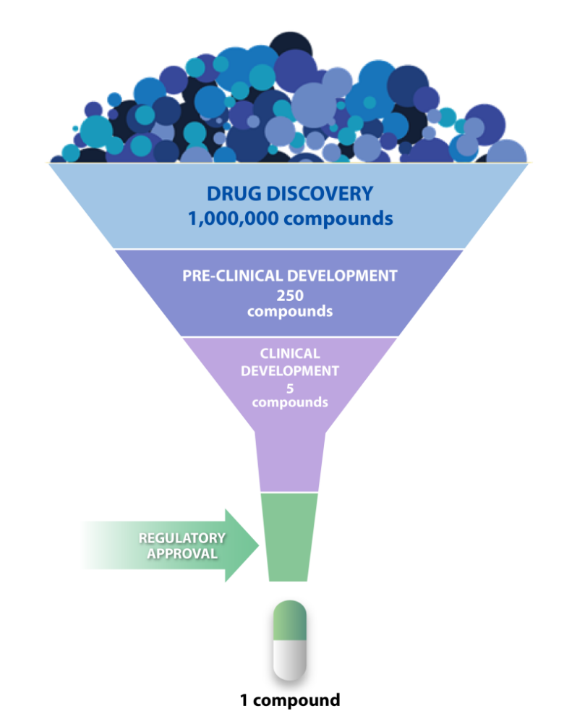
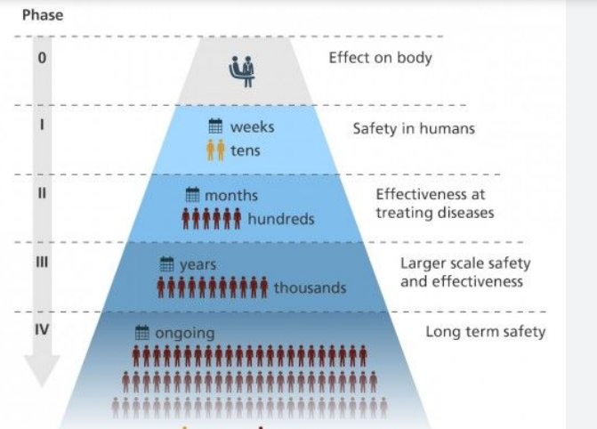

Slide 46
Regulation
Drug regulation is a complex but essential aspect of healthcare that ensures new medications are safe, effective, and manufactured to high standards.
The amount of data submitted can be enormous (over a million pages is frequent)
Nowadays submissions are electronic

Slide 47
Regulation
There is no global regulatory body
Marketing Authorization:
After successful trials, companies submit a marketing authorization application to regulatory bodies for approval to sell the drug
This process can take many months and even years

Slide 48
Data submitted
Chemical data – structure – synthetic method - stability -formulations
Non clinical biological data, animal testing
Full clinical data – including data on any failed trials

Slide 49
Pharmacovigilance
Pharmacovigilance is an ongoing process that monitors drug safety after approval. It involves collecting data on adverse drug events (ADEs) from healthcare providers (doctors and nurses) and patients.
Regulatory agencies like the FDA and EMA have systems in place to analyse these reports, which can lead to updates in labelling, risk management strategies, or even market withdrawals if necessary

Slide 50
Regulation of prices
Drug price regulation is a critical aspect of healthcare policy aimed at controlling the costs of pharmaceuticals to ensure affordability and access for patients. Various countries implement different mechanisms to regulate drug prices, which can significantly impact healthcare systems, pharmaceutical innovation, and patient access to medications.
In the UK NICE evaluates new and existing medicines and treatments to determine their clinical effectiveness and cost-effectiveness. This appraisal process informs whether a drug should be made available through the NHS.
Drugs may be approved but not be available to be paid for by the NHS

Slide 51
What happens next?
Marketing roll out - internationally
Pharmacovigilance
New formulations
New populations
Competition from the generic companies
Sale of drug to competitors or generics companies
Reinvest the money in further drugs

Slide 52
How much does it cost in all?
The top 20 global pharmaceutical companies collectively spent $139bn on R&D in 2022, down two per cent from 2021;
With longer cycle times, the average cost of developing a new drug rose by $298m to $2.3bn in 2022;
Average forecast peak sales per asset have decreased to $389 million in 2022, falling back from $500 million in 2021 and $422 million in 2020.
The average projected return on investment (ROI) in research and development (R&D) for global pharmaceutical companies has fallen to 1.2 per cent in 2022, down from the 2021 record of 6.8 per cent, according to research by Deloitte.
The time it takes for a new drug to progress from starting clinical trials to approval - increased to 7.09 years in 2022 from 6.9 years in 2021,
As a result, the estimated average cost of developing a drug, including the cost of failure, increased from $1,986 million in 2021 to $2,284 million in 2022

Slide 53
Only 1/3 of drugs make money based on original investment

Slide 54
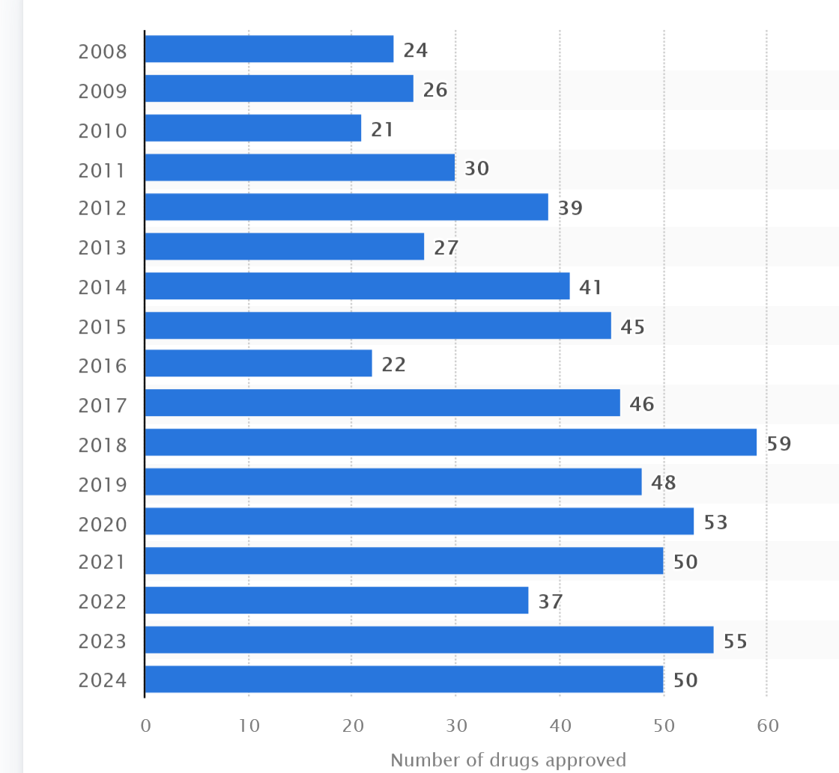
Number of new drugs(including biologicals) approved
Source FDA CDER

Slide 55
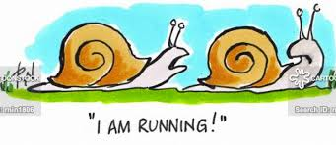
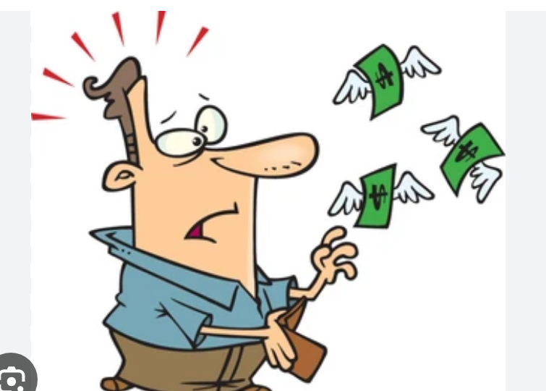

Conclusions
Drug development is a process that is
  Slow
  Risky
  Essential
Costly

Slide 56
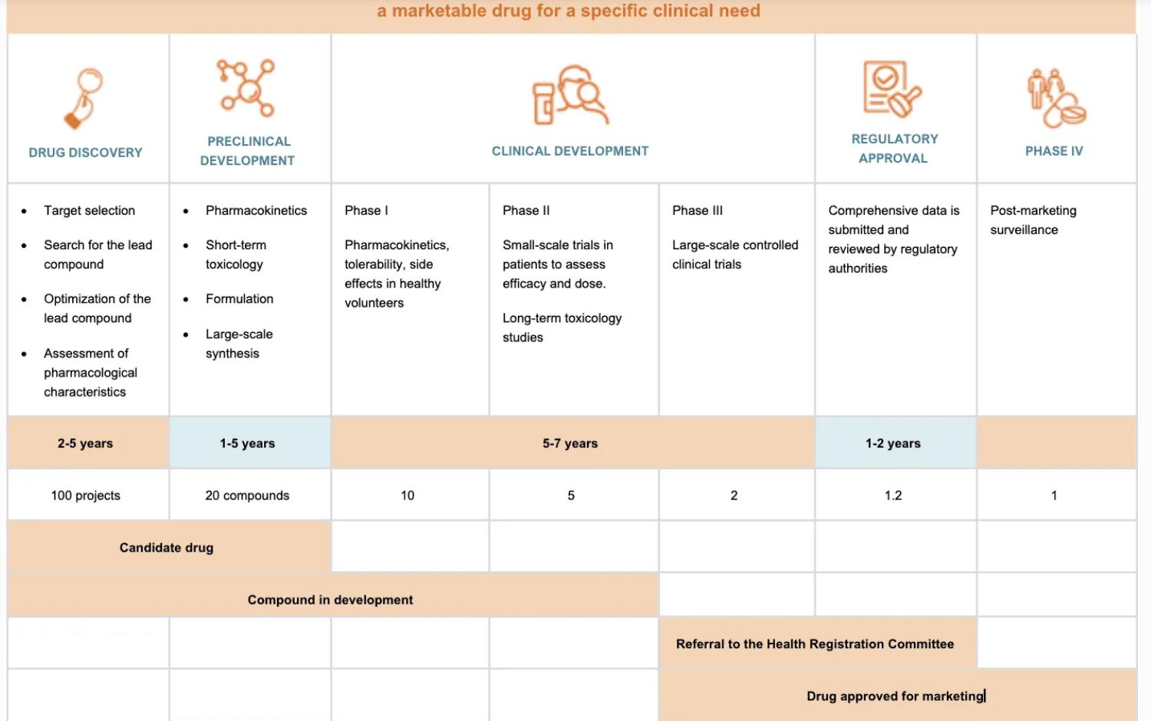
The complete process

Slide 57
Thank you for your attention

